Slide 1
PERFECTLY COMPETITIVE MARKET
PRESENTATION FOR ECONOMICS HONOURS SEMESTER II

Slide 2
MARKETS AND ITS FORMS
The four distinct market models are;
Perfect Competition
Monopolistic Competition
Oligopoly
Pure Monopoly

Slide 3
PERFECT COMPETITION - Characteristics
Large number of Buyers and Sellers
Standardized/Homogeneous Product
Price Takers
Free Entry and Exit
Perfect knowledge about the market condition

Slide 4
EQUILIBRIUM OF A PRICE TAKER FIRM IN SHORT RUN
In short run the number of firms is fixed in the industry and firms can only change its output level by changing the variable cost.
A Firm’s equilibrium point can be ascertained by the following two ways.
Total Revenue & Total Cost Approach
Marginal Revenue & Marginal Cost Approach

Slide 5
EQUILIBRIUM OF A PRICE TAKER FIRM IN SHORT RUN “TR & TC APPROACH”
A firm is in equilibrium and earns maximum profit when the difference between TR and TC is highest.
At any point, where TR touches TC curve, it will be a Break-even point and here firm will earn Normal Profit.
Normal profit does not mean Economic profit.

Slide 6
Perfect Competition: Price & Revenue
No: Output | Price | Total Revenue | Average Revenue | Marginal Revenue
1 | 10 | 10 | 10 | _
2 | 10 | 20 | 10 | 10
3 | 10 | 30 | 10 | 10
4 | 10 | 40 | 10 | 10
Hence, under perfect competition, Price=AR=MR

Slide 7
THE COMPETITIVE FIRM’S
DEMAND CURVE
Price
P_{m}
MR = AR = P
Quantity

Slide 8
The optimal level of output for a competitive firm is determined where Marginal Revenue (MR) is equal to Marginal Cost (MC)
Optimal Output Level
Rs
P*
MR = Demand or AR
Quantity

Slide 9
Optimal Output Level
Rs
MC
P*
MR = D=AR
Quantity

Slide 10
Optimal Output Level
Rs
MC
P*
MR = D=AR
Q*
Quantity

Slide 11
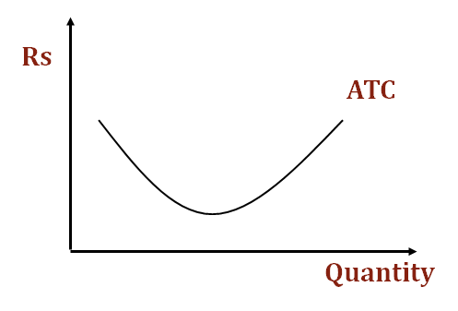
Average Total Cost
Average Total Cost (ATC) can be added to the graph to demonstrate the firm’s profit potential.
The per unit cost of producing a specific good.
The difference between ATC and product’s price equals the profit per unit of product.

Slide 12
EQUILIBRIUM OF A PRICE TAKER FIRM IN SHORT RUN “MR & MC APPROACH”
MR & MC approach states that a price taker firm is in equilibrium at a point where “MR or Price = MC”.
The firm’s equilibrium point does not ensure that it is producing that level of output which gives firm maximum profit.
In short run, a firm is faced with four types of product prices in the market which give rise to following results;
A firm earns Supernormal Profit
A firm earns Normal Profit
A firm incurs Losses but does not Close Down
A firm minimizes Losses by Shutting Down

Slide 13
Price
MC
ATC
P*
MR = D
AR = P
Quantity

Slide 14
MC
Rs
ATC
P*
MR = AR = P
Q*
Quantity

Slide 15
MC
Rs
ATC
P*
Profit
MR = D=
AR = P
Q*
Quantity

Slide 16
Supernormal Profit
Price - ATC = Profit per unit of output
Note: Price < ATC indicates a loss
It is important to note that profit in a perfectly competitive market will lead to firms wanting to enter that market
If enough firms enter, then the market supply curve will shift to the right.

Slide 17
Price
S
P_{e}
D
Q_{e}
Quantity

Slide 18
Price
S
S`
P_{e}
D
Q_{e}
Quantity

Slide 19
Profit
With the increase in Supply, price will be driven down.
With the lower price, profits will be driven out.

Slide 20
Loss
MC
Price
ATC
P*
Loss
MR = D
AR= P
Q*
Quantity

Slide 21
Price
S
P_{e}
D
Q_{e}
Quantity

Slide 22
Price
S
S
P_{e}
D
Q_{e}
Quantity

Slide 23
Normal profit
MC
Price
ATC
P*
MR = D
AR= P
Q*
Quantity

Slide 24
Summarise
Firm is in equilibrium when MC =MR
Firm maximizes the profit when the price exceeds the AC.
In the short run firms earn either supernormal profits(when AR exceeds AC),losses(when AC exceeds the AR)or will be forced to shut down(when AR falls short of AVC)

Slide 25
Long Run Equilibrium
Long run shows the entry and exit of the firms into the industry. If firms make supernormal profits in the SR, new firms will enter the industry till the excess profits get wiped out.
Similarly, If firms are making losses, existing firms will quit the industry so that the remaining ones will be able to make at least normal profits.
Thus, under long run, firm and industry under perfectly competitive market will earn only normal profits.

