Slide 1
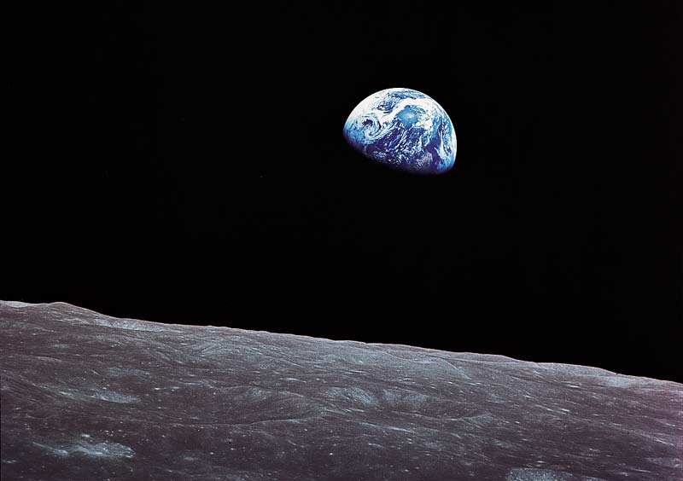
EFFECTS OF POLLUTION ON ECOSYSTEM AND BIOLOGICAL DIVERSITY
BOTANY( Semester – I )

Slide 2
OUR MOTHER EARTH,
The Nature
Biological Diversity
Ecosystem
Pollution and its effects

Slide 3
Biological Diversity of the World
Biological Diversity of Indian Subcontinents
Flora and Fauna | Number of Sps.
plants | 2,70,000
Algae | 40,000
Fungus | 72,000
Cyanobacteria | 4,000
Mammals | 4,650
Angiosperm Birds | 9,700
Reptiles | 7,150
Fishes | 26,959
Amphibians | 4,780
Insects | 10,25,000
Arthropods | 43,000
Molluscs | 70,000
Helminthes | 25,000
Protozoans | 40,000
Others | 1,10,000
Flora and Fauna | Number of Sps.
Angiosperms | 17,500
Gymnosperms | 64
Pteridophyta | 1,100
Bryophyte | 2,850
Lichens | 2,000
Algae | 6,500
Fungus | 14,500
Mammals | 300
Birds | 1,232
Reptiles | 456
Amphibians | 209
Fishes | 2,546
Arthropods | 68,389
Molluscs | 5,070
Protozoans | 2,577
Others | 8,329
Source: FSI(2009)

Slide 4
Biodiversity = Flora + Fauna i.e. Plants and Animals together ( BIOTIC COMPONENTS OF ECOSYSTEM)
General Ecology
ECOLOGY – how organisms interact with one another and with their environment
ENVIRONMENT – living and non-living components
ABIOTIC – non-living component or physical factors as soil, rainfall, sunlight, temperatures
BIOTIC – living component are other organisms

Slide 5
ECOLOGICAL ORGANIZATION
INDIVIDUAL – individual organisms
POPULATION – organisms of same species in same area (biotic factors)
COMMUNITY – several populations in same area (biotic factors)
ECOSYSTEM – community plus abiotic factors
BIOSPHERE – all ecosystems on earth –
Forest, Marine

Slide 6
ECOLOGY OF INDIVIDUALS
Homeostasis – delicate balance
Components
Physiological Ecology
Temperature and Water Balance
Light and Biological Cycles
Physiological Ecology and Conservation

Slide 7
Environmental Problems
A. Aquatic Environment Issues – Water pollution, Water Diversion, Overfishing
B. Air Quality Issues – Acid rain, Air Pollution, Nuclear Pollution
C. Climate Change Issues – Greenhouse Effect, Ozone Depletion
D. Terrestrial Environment Issues –Deforestation, Soil pollution, Waste Disposal, Mining
E. Population Growth Issues – Habitat Destruction, Farming Practices, Fertilizers & Pesticides

Slide 8
Pollution
Definition: Any undesirable change in the environment caused by Human Activities

Slide 9
Environmental Pollution
Air Pollution
Water Pollution
Soil Pollution
Noise Pollution
Radioactive Pollution
Thermal Pollution

Slide 10
Aquatic Environmental Issues
Water pollution
Eutrophication
Ocean Dead Zones
Thermal Pollution
Overfishing

Slide 11
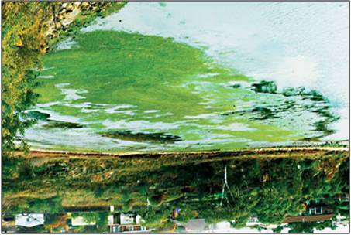
Eutrophication
Eutrophication – bodies of water becomes enriched with nutrients. This can be a problem in marine habitats such as lakes as it can cause algal blooms.
run-off from fertilizers, into nearby water causing an increase in nutrient levels.
It causes phytoplankton to grow and reproduce more rapidly, resulting in algal blooms.
This bloom of algae disrupts normal ecosystem functioning and causes many problems.
The algae may use up all the oxygen in the water, leaving none for other marine life. This results in the death of many aquatic organisms such as fish, which need the oxygen in the water to live.
The bloom of algae may also block sunlight from photosynthetic marine plants under the water surface.
Some algae even produce toxins that are harmful to higher forms of life. This can cause problems along the food chain and affect any animal that feeds on them.

Slide 12
Climate Change Issues
Greenhouse Effect - warming that results when the atmosphere traps heat radiating from Earth toward space.
Ozone Depletion - ozone layer is deteriorating due to the release of pollution containing the chemicals chlorine and bromine (chlorofluorocarbons or CFCs)

Slide 13
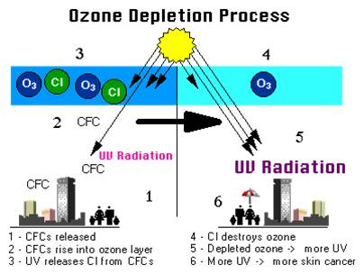
Ozone Depletion

Slide 14
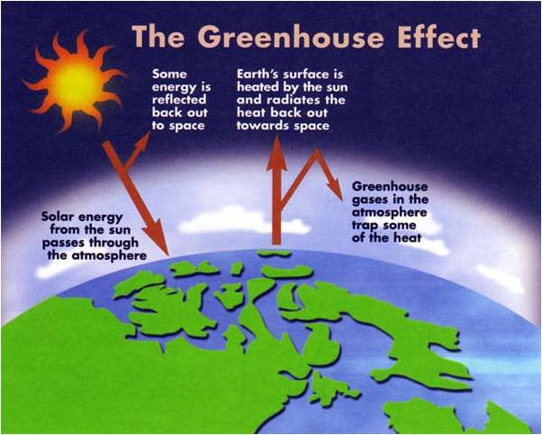
Greenhouse Effect

Slide 15
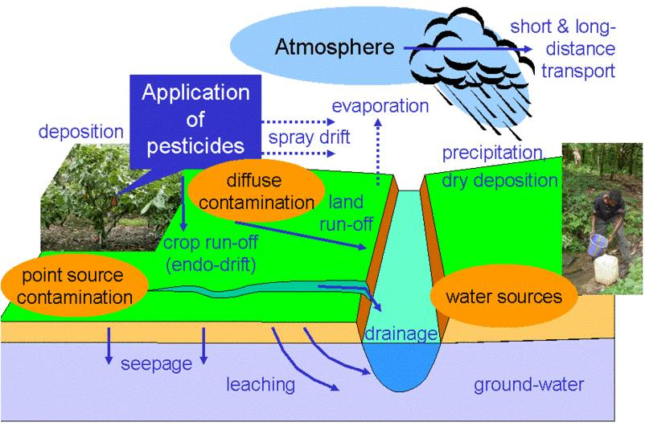
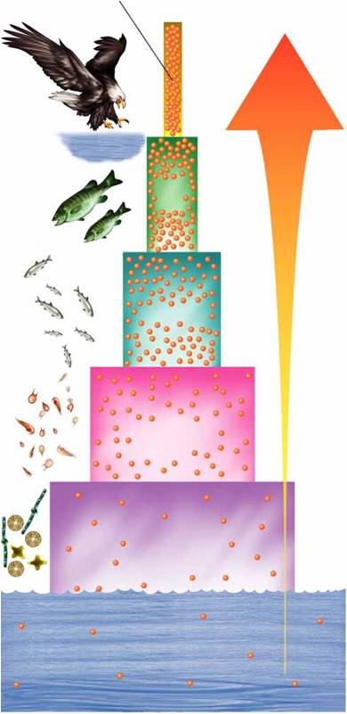
Fertilizers and Pesticides

Slide 16
Nonrenewable vs. Renewable Energy Sources
Non-renewable energy sources – fossil fuels as coal, oil and natural gas as well as nuclear fuels – limited supply will run out and have negative environmental impacts
Renewable energy sources – sun, wind, waves, heat, hydropower and biomass that can be used again and again and is cleanest energy sources.
There are pros and cons for each type of energy

Slide 17
Man affects his Environment through the change of:
Land Use
&
Pollution

Slide 18
Deforestation
Effects on Environment :
atmospheric carbon dioxide concentration increases
soil erosion by heavy rain or strong wind
no root to hold soil particles together
soil being washed into rivers ⇒ fills up the river bed ⇒ causes flooding

Slide 19
Deforestation
Effects on Environment :
destroys natural habitats & causes loss of species
cause extinction of species because of destruction of natural habitat
loss of important medicines

Slide 20
Monoculture
Effects on Environment :
increase in pest population ∵monoculture enables pests to have continual supply of food
exhaustion of particular type of minerals ∵the same type of plants draws particular types of mineral from the soil for a long time

Slide 21
Pollutants
Smoke & Exhaust Fumes
Domestic Wastes
Agricultural Wastes
Industrial Wastes
Noise

Slide 22
Effect of Pollutants on Human Health & the Environment

Slide 23
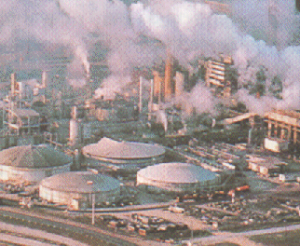
Smoke & Exhaust Fumes
Carbon Monoxide
form carboxyhaemoglobin permanently with haemoglobin in blood which reduces the oxygen-carrying capacity of blood
Health Effect: slow response, fainting and even death

Slide 24
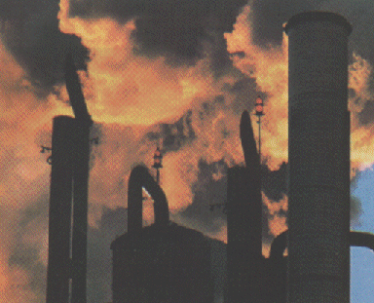
Carbon Dioxide
accounts for Greenhouse Effect
causes melting of polar ice ⇒ increases in sea level ⇒ causes flooding of cities

Slide 25
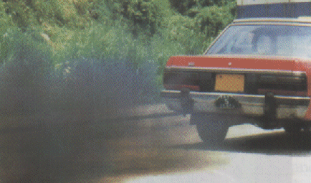
Carbon Particles :
Environmental Effect: cover plants & make them unable to carry out gaseous exchange & photosynthesis
Health Effect: cause respiratory diseases
Lead : from cars
Health Effect: affect mental development of baby & child, cause headache, irritability, fatigue & depression

Slide 26
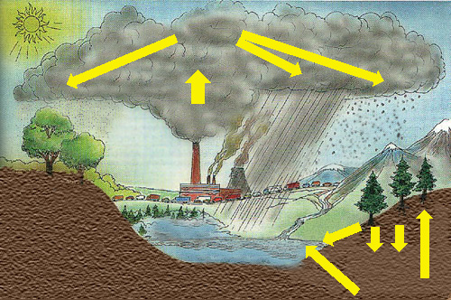
Sulphur Dioxide & Nitrogen Dioxide
Environmental Effect: produce acid rain which is corrosive to buildings and plants & fish are unable to survive in acidic conditions
H₂SO₄ & HNO₃
Dry fallout
SO₂ & NO_{x}
Acid rain
Acid snow
Die off of aquatic life
Acid leaching

Slide 27
Smog Formation
pollutants trapped by a layer of warm air above so that it cannot rise and disperse
a mixture of poisonous gases & fog
Health Effect: irritates eyes & lungs
Environmental Effect: toxic to plants
CFCs (chlorofluorocarbons)
Environmental Effect: reduce amount of ozone in atmosphere
Health Effect: increase chances of skin cancer

Slide 28
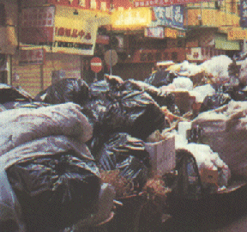
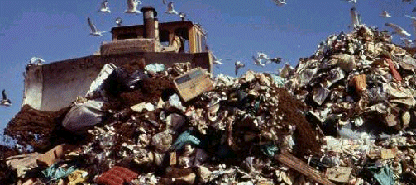
Domestic Wastes
Rubbish
Environmental Effect: give off bad smell & attract pests
Metal Cans & Plastics
Environmental Effect: non-biodegradable which needs plenty of space for landfilling
Detergents

Slide 29
Environmental Effect :
create foam on surface, decrease oxygen content in rivers, living organisms suffocate & die
increase phosphate ions, cause algal bloom (eg. red tides)
affect the functioning of sewage treatment plant by killing micro-organisms which the treatment depends

Slide 30
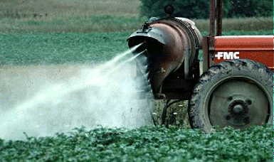
Agricultural Wastes
Inorganic Fertilizers
Environmental Effect :
cause rapid growth of algae (e.g. red tides)
use up lots of O₂ in water
fish & other organisms die from suffocation

Slide 31
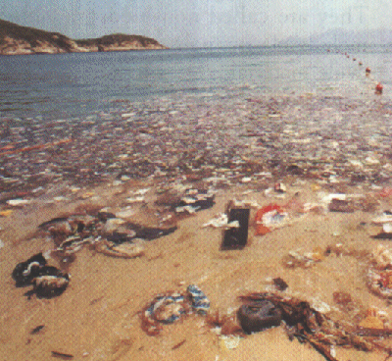
Manure
Environmental Effect :
decomposers increase rapidly due to sufficient food supply
O₂ content in water decreases
cause suffocation of fish & other organisms

Slide 32
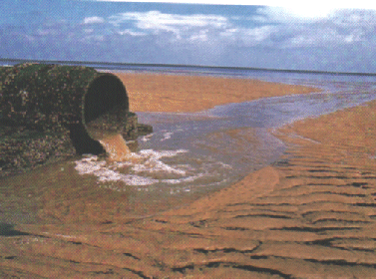
Industrial Wastes
Soluble Poisonous Heavy Metal Elements
Environmental Effect :
accumulate along the food chain & cause death when in high concentration

Slide 33
Why we need Conservation ?
rapid growth of population has led to increase in demand for land & thus destruction of natural habitat

Slide 34
Conservation
Definition :
wise use of natural resources,
least disturbance to the environment and
give good quality of life to man

Slide 35
Biodiversity conservation:
In-situ Conservation:
National Park
Sanctuary
Reserve Forest
Protected area
Biosphere Reserve
Ex-Situ Conservation:
Zoo
Botanical Garden
Seed Bank etc.

Slide 36
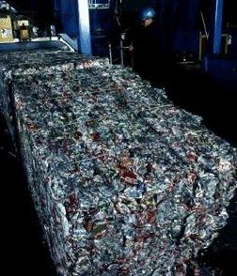
Ways of Conservation
Recycling of Used Materials
e.g. recycle paper & aluminum cans
Economical Use of Natural Resources
e.g. develop other energy sources like solar energy & nuclear energy
Pollution Control
e.g. content of lead & sulphur in petrol
e.g. install catalytic converter in motor cars
e.g. sewage treatment

Slide 37
Sewage Treatment
Sedimentation
settle down solid substances to form sludge
Decomposition
aerobic respiration of microorganisms in aeration tank by bubbling air in order to oxidize organic compounds into inorganic compounds

Slide 38
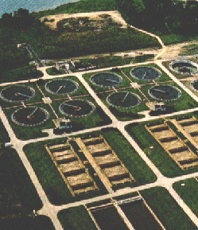
Sewage Treatment
Fermentation
microorganisms in digester to carry out anaerobic respiration
produce methane gas
can be used as fuel to drive the sewage treatment plant
dry sludge can be used as fertilizers

Slide 39
Ways of Conservation
Legislation
control the amount of pollutants discharged
Education
by mass media (besides normal schooling)
Birth control
to decrease the stress on resources

Slide 40
Everyday Solutions
Conserve
Increase Efficiency
Recycle
More Emphasis on Research -Global Pollution

Slide 41
THANK YOU ALL

